Slide 1
Introduction to
single-cell analysis
Francesca Drummer

Slide 2
Before we begin…
Data analysis is no magic ✨ you can only get out what you put in.
Design you experiment according to your question.
Make a pilot before a big experiment (to test signal).
Don’t just run pipelines without thinking.
And lastly: You are the BETTER data analysi

Slide 3
Learning goal of today
Understand single-cell tool landscape in Python
Access github repo
Load single-cell data as Anndata object

Slide 4
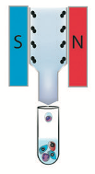
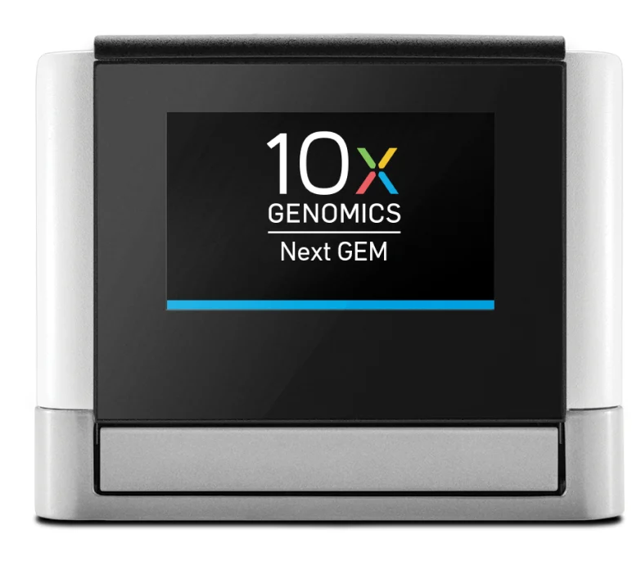
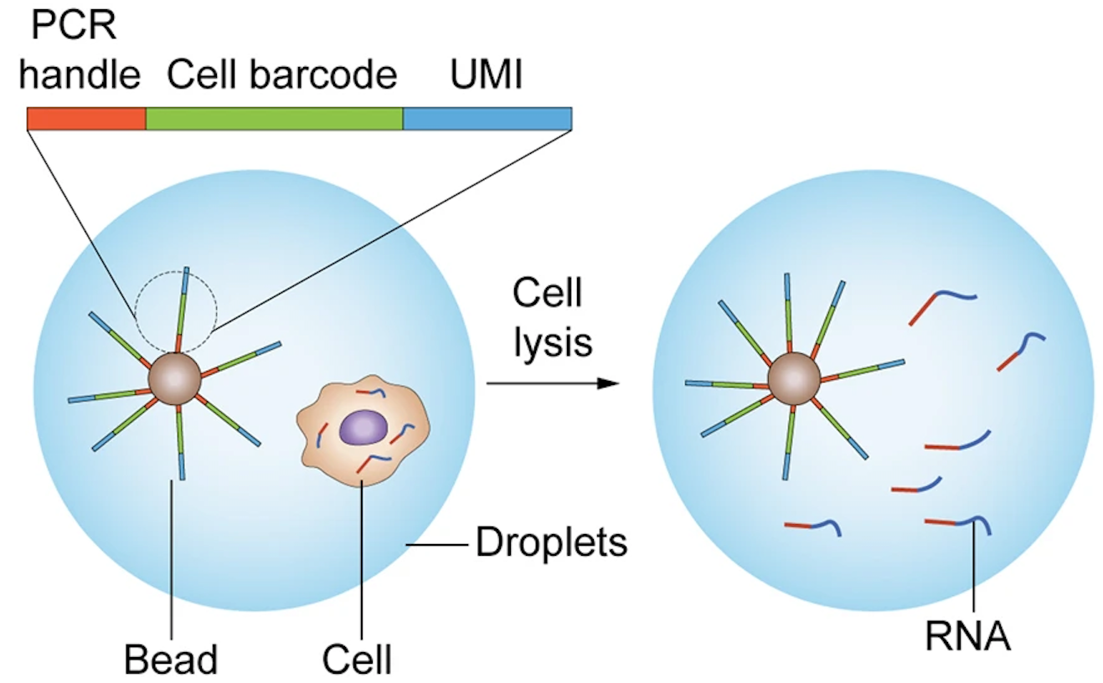
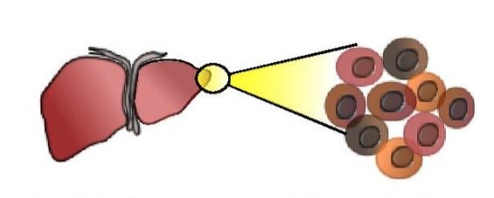
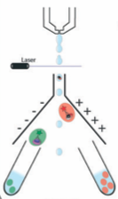
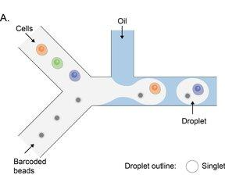
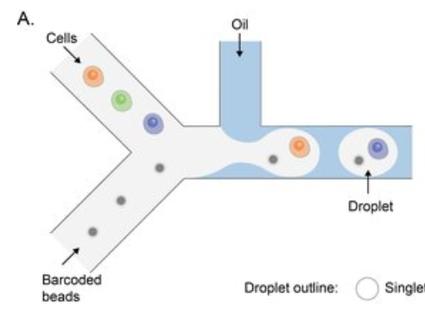
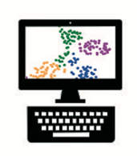
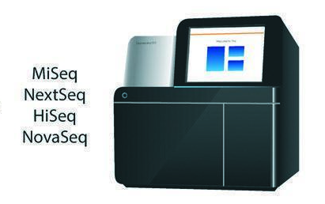
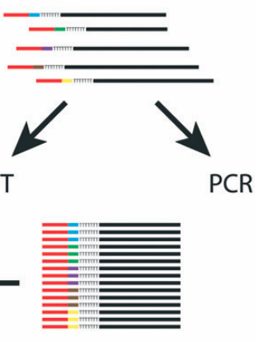
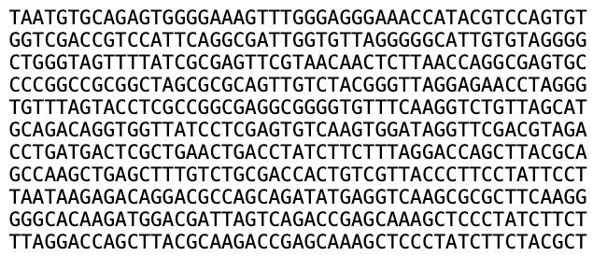
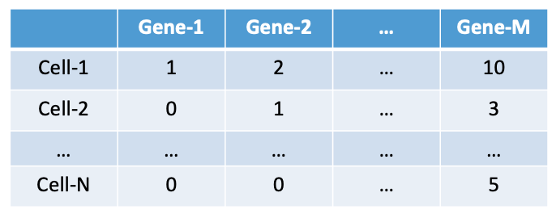

Single-cell RNA-sequencing data
Dissociation
Sorting
Single-cell Capture
Lian, Ma et al. (2022). Total-mRNA-Aware Analysis for Droplet-Based Single Cell Sequencing. 10.21203/rs.3.rs-2211167/v1.
Demultiplex,
Sequence Alignment,
Data Analysis
Dim-2
Sequencing
RT-PCR
Salomon, Robert, et al. Lab on a Chip (2019)
Dim-1
Goal: Familiarize and implement some outstanding computational tools used by the field
Notes:
scRNA-seq is an extremely powerful technique
Allows us to ask biological questions at an unprecedented level
Has already seen applications in numerous biological fields (embryogenesis, cancer, autoimmune diseases, neuroscience etc.)
Will play a major role in Human Cell Atlas
scRNA-seq measures the abundance of mRNA molecules per cell
Tissue digested during single-cell dissociation: breaking down solid tissue into individual, separated cells.
Individual cells are sorted to isolate specific populations of interest. Two different protocols, plate-based and droplet-based.
Plate-based: isolate cells in to wells on a plate
Droplet-based: capture cells in microfliodic droplets
Individual cells are then captured using platforms like 10x Genomics, where each cell receives a unique barcode.
Individual cells are encapsulated in tiny oil droplets (nanoliter-sized)
Each droplet contains: one cell + one bead + lysis buffer + RT reagents
The bead carries millions of copies of oligonucleotides with a unique cell barcode
Upon lysis the cell’s mRNA is instantaneously released and captured by the barcoded oligonucleotides that are attached on the beads.
Next, the droplets are collected and broken to release single-cell transcriptomes attached to microparticles (STAMPs).
This is followed by PCR and reverse transcription (RT) to capture and amplify the transcripts.
Finally, tagmentation takes place where the transcripts are randomly cut and sequencing adaptors get attached. This process results in sequencing libraries that are ready for sequencing as described above. In microfluidic based protocols only about 10% of the transcripts of the cell are recovered[Islam et al., 2014]. Notably, this low sequencing is sufficient for robust identification of cell types.
Sequencing get i) cell barcode = identifies the cell, ii) UMI = identifies individual RNA molecule, iii) actual gene sequence (cDNA copy of original mRNA). The sequencing machine literally "reads" these fragments base by base, determining whether each position is an A, T, G or C. Output is a FASTQ file which contains: reads of about 50-150 nucleotides and quality scores
Demultiplex and sequence alignment done by 10X genomics software CellRanger for example. The output is a count matrix: cell by gene

Slide 5
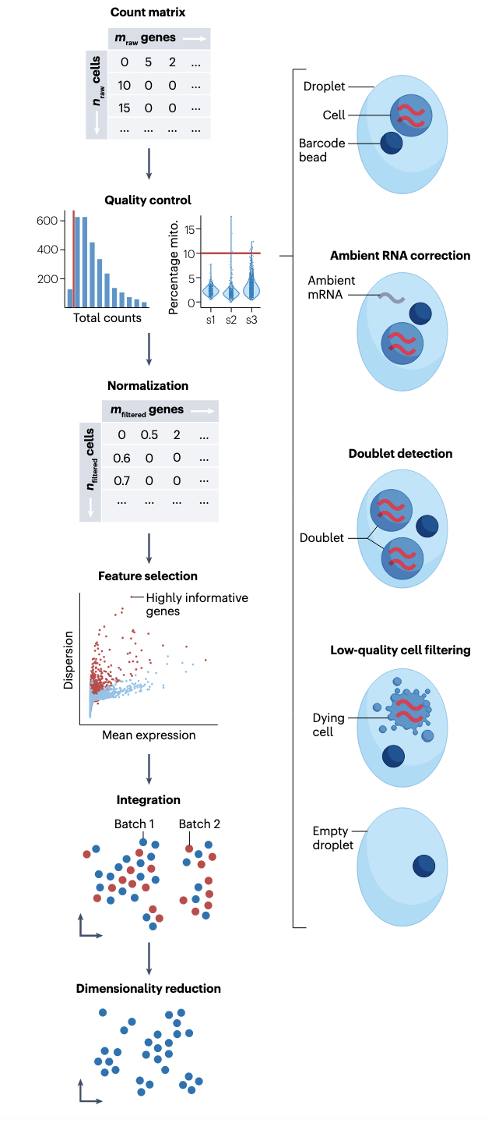
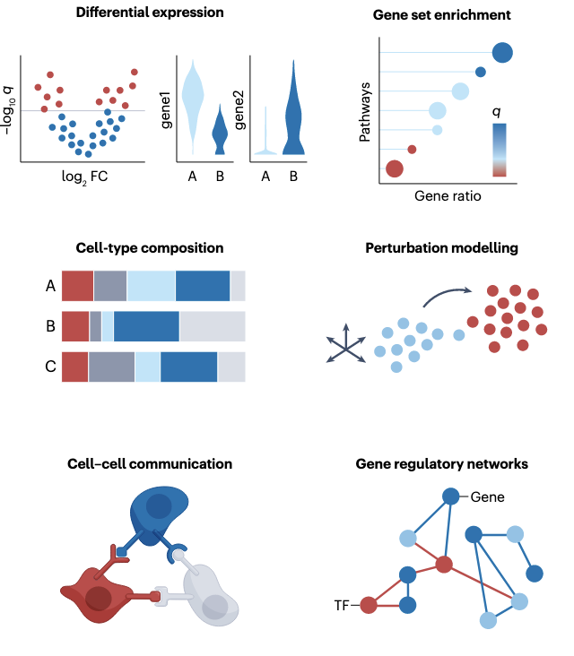
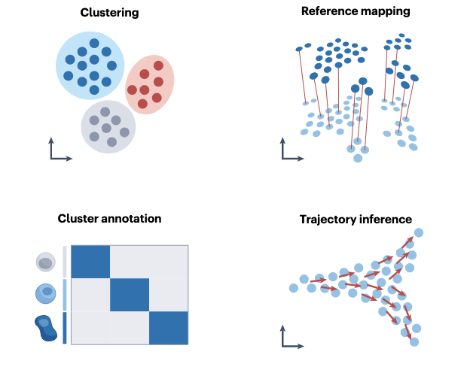
Overview of unimodal analysis steps for scRNA-seq
Preprocessing & visualization
3. Revealing mechanisms
2. Identifying cellular structures
Heumos L. & Schaar A. et al., 2023 Nat. Rev. Genetics
Notes:
article serves as an entry point for novices in the field of single-cell (multi-)omic analysis and guides advanced users to the most recent best practices.

Slide 6


Single-cell analysis guides
www.sc-best-practices.org/
interoperability
bioconductor.org/books/release/OSCA/
Heumos L. & Schaar A. et al., 2023 Nat. Rev. Genetics
Notes:
article serves as an entry point for novices in the field of single-cell (multi-)omic analysis and guides advanced users to the most recent best practices.

Slide 7

Python packages to analyze single cell data
Python packages are pre-written sets of code that one can simply “load” or “import” onto Jupyter Notebook
Packages we will rely on mostly:
Numpy: Working with arrays, matrices
Pandas: Working with data frames
Matplotlib: Plotting functions
Seaborn: Additional plotting functions
Scanpy: Package developed for single-cell data analysis
Highlights:
scanpy contains Python implementation of the most widely used single-cell RNA-sequencing methods (Data Normalization, PCA, tSNE, UMAP, Diffusion Maps, trajectory inference, batch correction etc.)
Developed in Theis’ Lab by Alex Wolf - Wolf et. al. Genome Biology. (2018)
A lot of help available online: https://scanpy.readthedocs.io/en/stable/

Slide 8
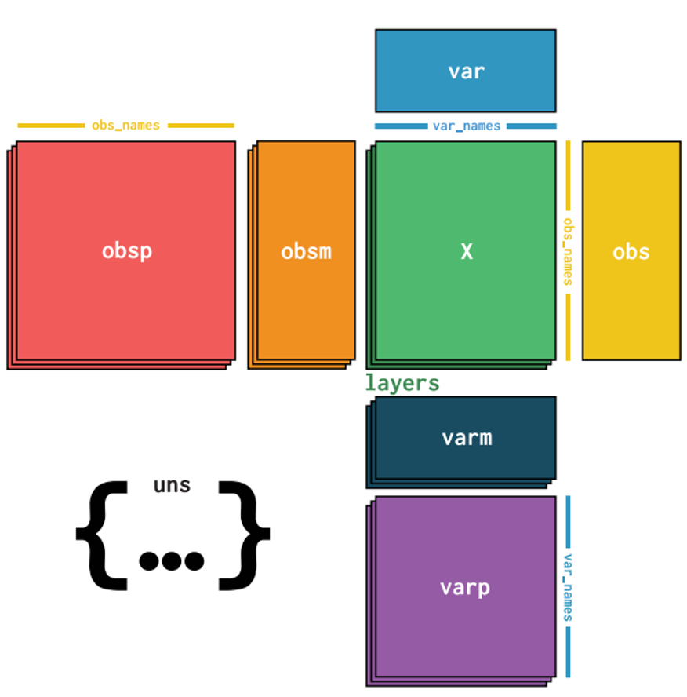
Anndata structure
•Easy way to track all data/metadata
•Effective when one gets deep into data analysis and meta data start accumulating
Each row corresponds to the same cell
scanpy uses the annotated data structure
(https://anndata.readthedocs.io/en/latest/index.html)
Each column corresponds to the same gene

Slide 9


AnnData
Introduction

Slide 10
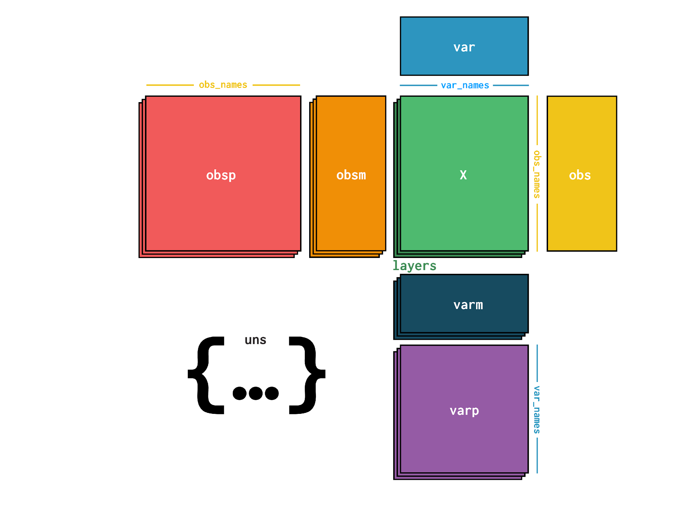
anndata Packages
Overview
anndata.AnnData object
anndata.concat for combining
anndata.io submodule
anndata.experimental submodule

Slide 11



Data Model
Concrete examples
X Element
Main EXperimental data readout i.e., observation (obs) by feature (var) matrix
Cell-x-gene counts
Glomeruli-x-protein abundance
Patient-x-disease state
Sparse ({scipy,cupyx}.sparse.cs{c,r}_{matrix,array}) or dense ({numpy,cupy}.ndarray) matrix
layers Element
Alternatives to X with same dimensionality
Normalized Cell-x-gene counts
Different storage format

Slide 12

Data Model
Concrete examples
obs element i.e., stacked 1D vectors with the same number of elements as the obs axis of X
Alternative labels (i.e., strings)
barcodes, names etc)
Derived statistics (i.e., numeric)
total mRNA count, probability of viability
Experimental readouts of your observations (i.e., numeric, boolean, etc)
Cell viability, size, volume etc.
Prior knowledge
Cell type ontology
In-silico results
Clustering (Cell type labels, niche classification)

Slide 13
Data Model
Concrete examples
var is same as obs but for feature axis
Alternative labels (strings)
different gene names
Derived statistics (numerics)
total mRNA count
number of cells expressing
Classification result
Prior knowledge
Up-or-down regulated in system
Gene expression network label
Gene type (ribosomal, mitochondrial etc.)

Slide 14
Data Model
Concrete examples
obsm element i.e., stacked ND vectors along obs axis
Dimensionality reduction results
PCA
UMAP
Experimental readout
Spatial location

Slide 15
Data Model
Concrete examples
varm element i.e., stacked ND vectors along var axis
PCA loadings

Slide 16
Data Model
Concrete examples
xxxp elements i.e., n_obs x n_obs matrices
Neighborhood graphs
Self-similarity matrices
uns element i.e., unstructured data
Method parameters
Plot-rendering settings

Slide 17
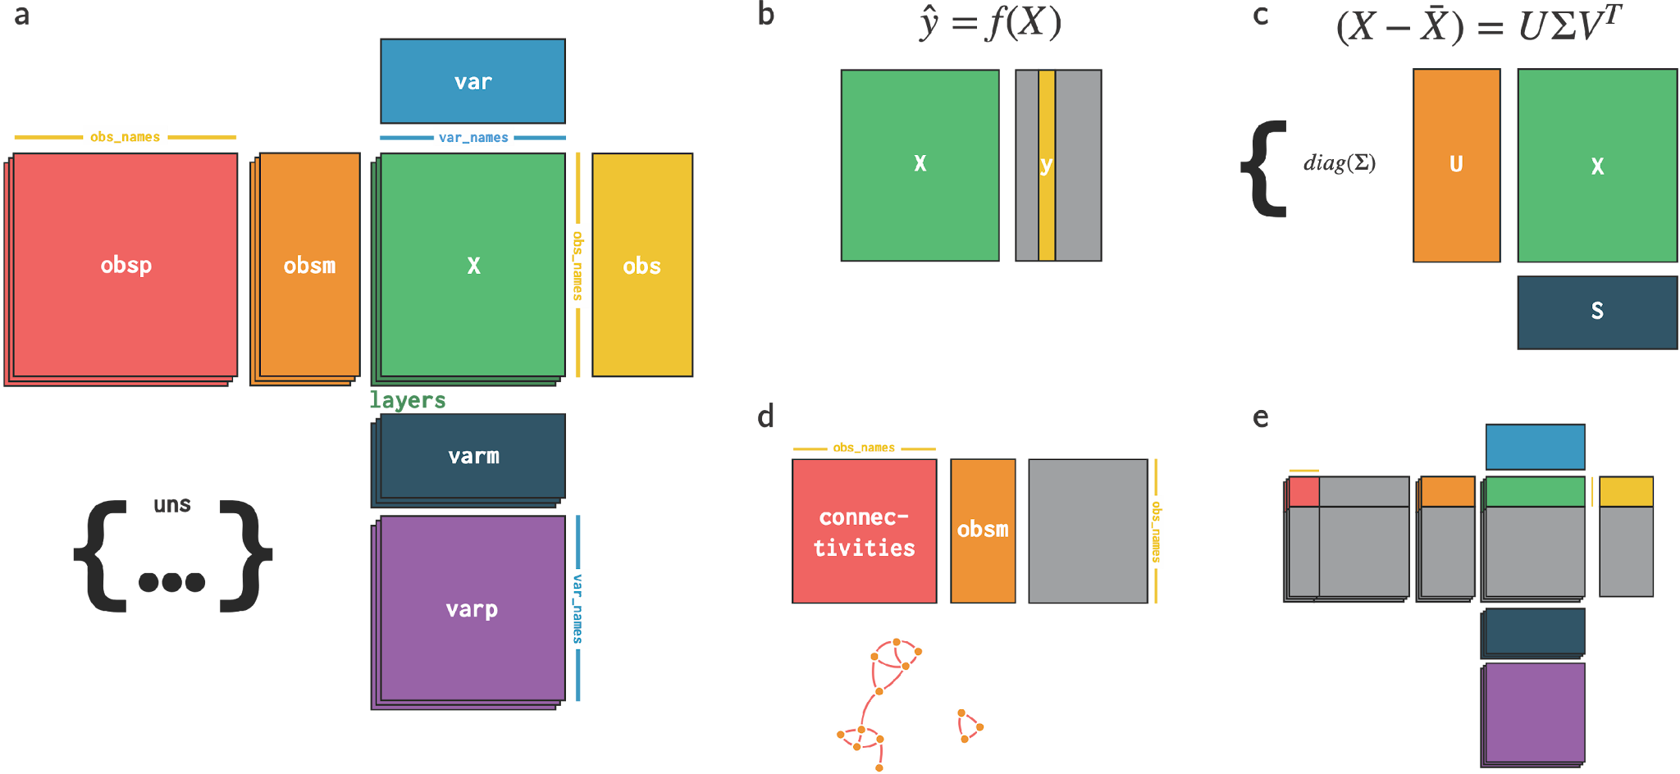
Data Model
Overview of use-cases
Linear Model
PCA
Nearest Neighbors
Subsetting

Slide 18
Processing single-cell RNA-sequencing data
scRNA-seq data matrix
Pre-process and QC
Data Normalization
Identifying Empty droplets (ambient RNA)
or doublets (multiple cells, one barcode)
New version of CellRanger implements EmptyDrops (Lun et al.)
Library size distribution; Number of cells each gene is expressed in
Downstream analysis
Mitochondria or ribosomal expression
Number of uniquely expressed genes per cell

Slide 19
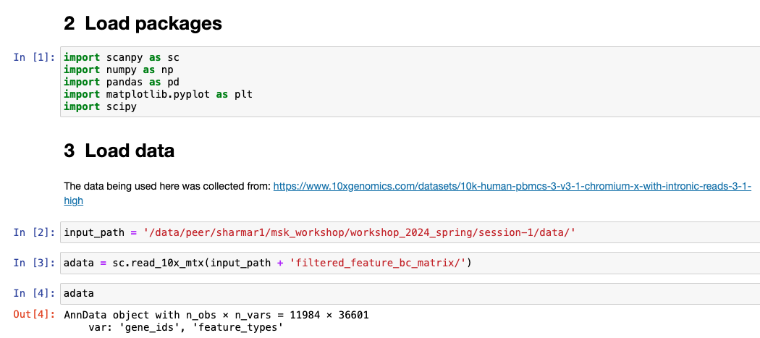
Every analysis starts by loading packages and data
Number of cells
Number of genes
Other attributes like obsp, obsm, varm etc will be added as the analysis progresses.

Slide 20
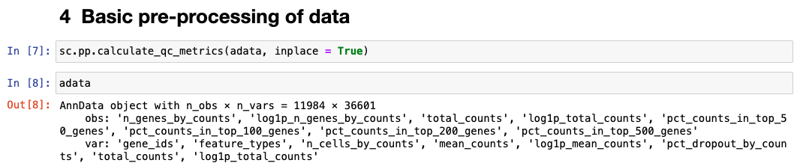
Pre-processing and QC of the data
Automatic QC metrics from scanpy. For more details, see:
https://scanpy.readthedocs.io/en/stable/generated/scanpy.pp.calculate_qc_metrics.html
Notes:
E.g. “total_genes_by_counts”. Number of genes with positive counts in a cell.

Slide 21
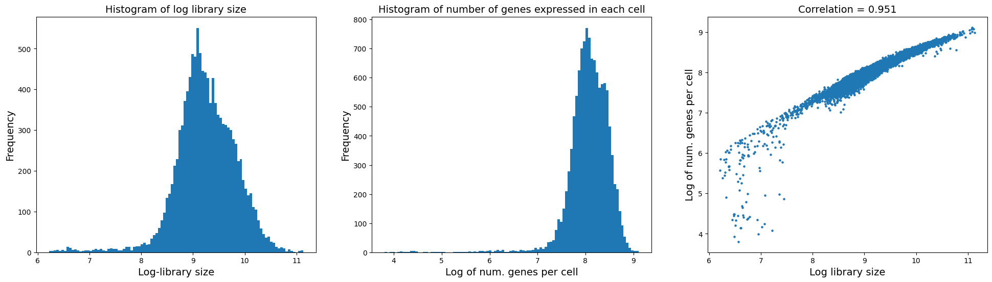
Pre-processing and QC of the data
The scatter plot on the right however suggests that there are some cells with low number of genes expressed but have a decent library size.
These cells are likely low quality and should likely be removed. We have two options:
Remove them now: [sc.pp.filter_cells(data, min_counts=None, min_genes=None, max_counts=None, max_genes=None, inplace=True, copy=False)] sc.pp.filter_cells(adata, min_genes = np.exp(6))
Remove them after some downstream analysis

Slide 22
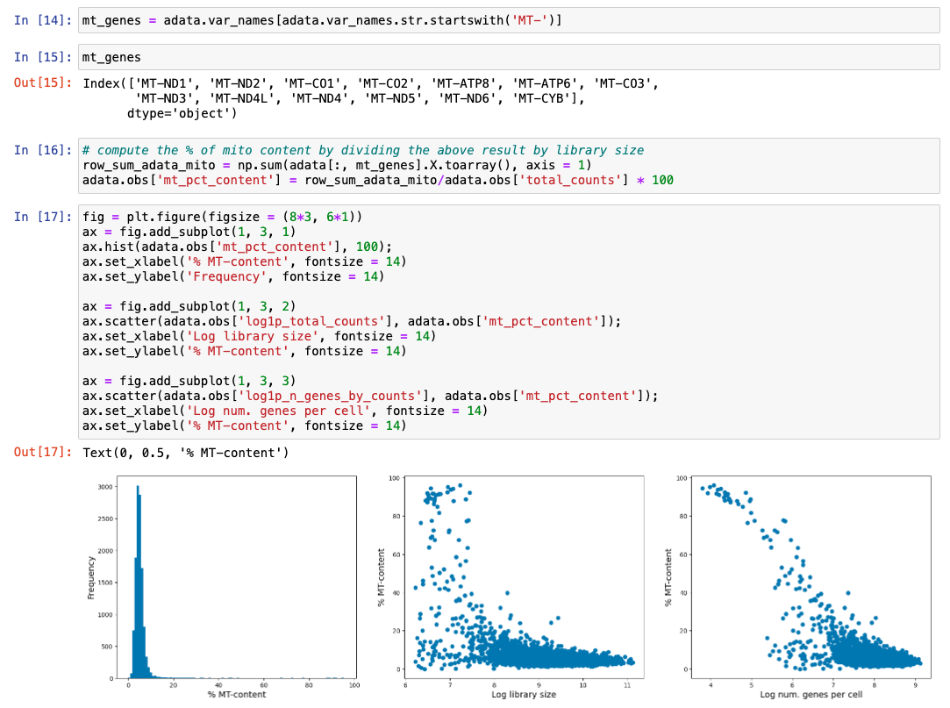
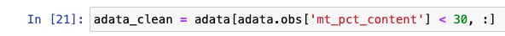
Pre-processing – mitochondrial content
The presence of high mitochondrial gene expression can indicate cells undergoing apoptosis.
A typical step in scRNA-seq analysis is to remove cells with high mitochondrial RNA expression.
Question: Should we be doing this from the beginning itself?
=> In majority cases it may be important to remove them from any analysis as they can corrupt co-variance in the data. However, if you want to study cells under apoptosis then you should not do this.
Yates, J., Kraft, A. & Boeva, V. Filtering cells with high mitochondrial content depletes viable metabolically altered malignant cell populations in cancer single-cell studies. Genome Biology 26, 91 (2025).

Slide 23
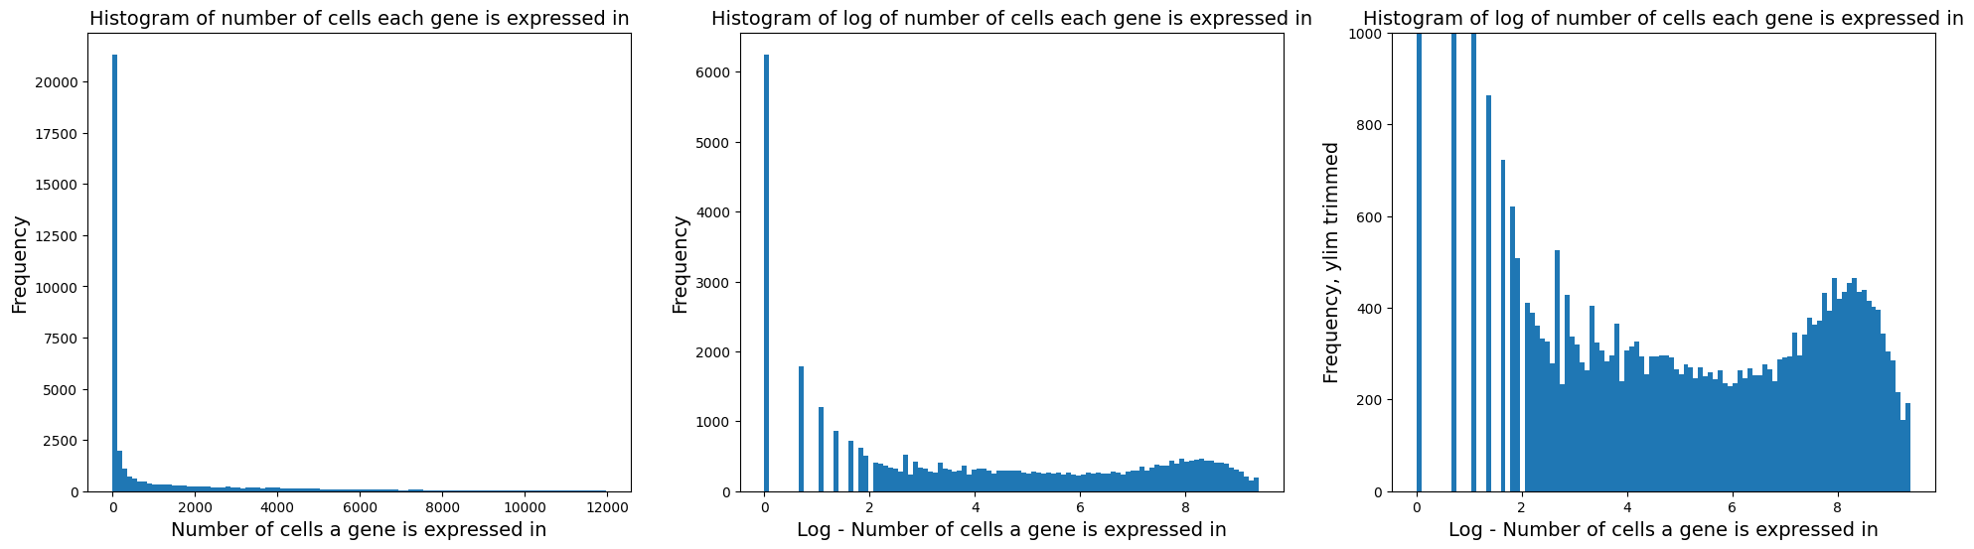
Pre-processing and QC of the data
Check the distribution of number of cells each gene is expressed in
Based on the distribution, we see many genes expressed in 0 or low number of cells. Questions to ask ourselves:
Can I remove genes expressed in very few cells? Generally, yes but context is always important. E.g.: data with different conditions where a gene may be perturbed compared to control.
In current scenario, we can remove cells expressed in less than a handful of cells (red line above)

Slide 24
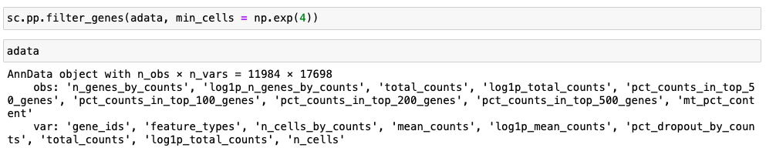
Pre-processing and QC of the data
Number of genes reduced from ~33,000 to 13,730

Slide 25
Data QC - Summary
Data QC does not always imply we want to forcefully clean data
We want to see if there are red flags
If the flags are obvious, we can remove them. Else, we keep the flags in mind while we analyze the data downstream and clean data later using additional (biological) reasoning
By doing basic QC we get a “feel” for the data
Additional QC metrics:
Study ribosomal content like we did for mitochondrial content
Use advanced tools such as CellBender to correct gene expression counts

Slide 26
Post data pre-processing: - Data normalization - Highly Variable Genes - PCA - Nearest Neighbor Graph - Visualization - Clustering

Slide 27
Data normalization
Library size normalization:
To correct for total mRNA count (biases due to sequencing depth) that may be driving cell-cell heterogeneity
Often the variance in cells seems to be driven largely by sequencing depth differences, which is not necessarily biologically relevant.
Most common method: Median library size normalization + log transformation
Inspired by TPM normalization in bulk data analysis
Assumes all cells should have the same total mRNA count, not always a good assumption
Other statistically principled tools:
Scran (https://genomebiology.biomedcentral.com/articles/10.1186/s13059-016-0947-7)
Sctransform (https://genomebiology.biomedcentral.com/articles/10.1186/s13059-019-1874-1)

Slide 28
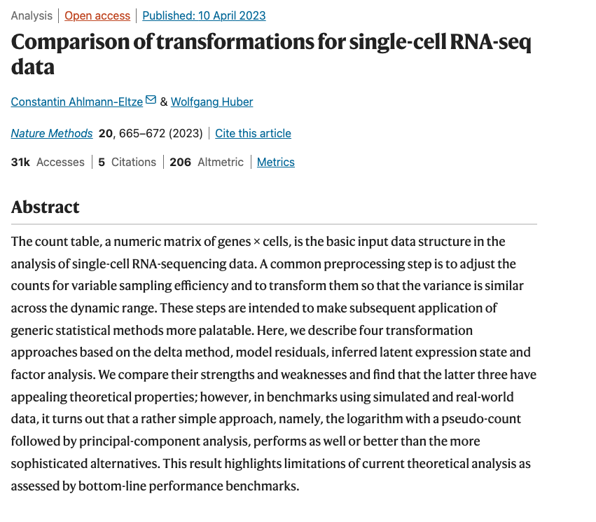
Data normalization
Library size normalization:
To correct for total mRNA count (biases due to sequencing depth) that may be driving cell-cell heterogeneity
Often the variance in cells seems to be driven largely by sequencing depth differences, which is not necessarily biologically relevant.
Most common method: Median library size normalization + log transformation
Inspired by TPM normalization in bulk data analysis
Assumes all cells should have the same total mRNA count, not always a good assumption
Other statistically principled tools:
Scran (https://genomebiology.biomedcentral.com/articles/10.1186/s13059-016-0947-7)
Sctransform (https://genomebiology.biomedcentral.com/articles/10.1186/s13059-019-1874-1)

Slide 29
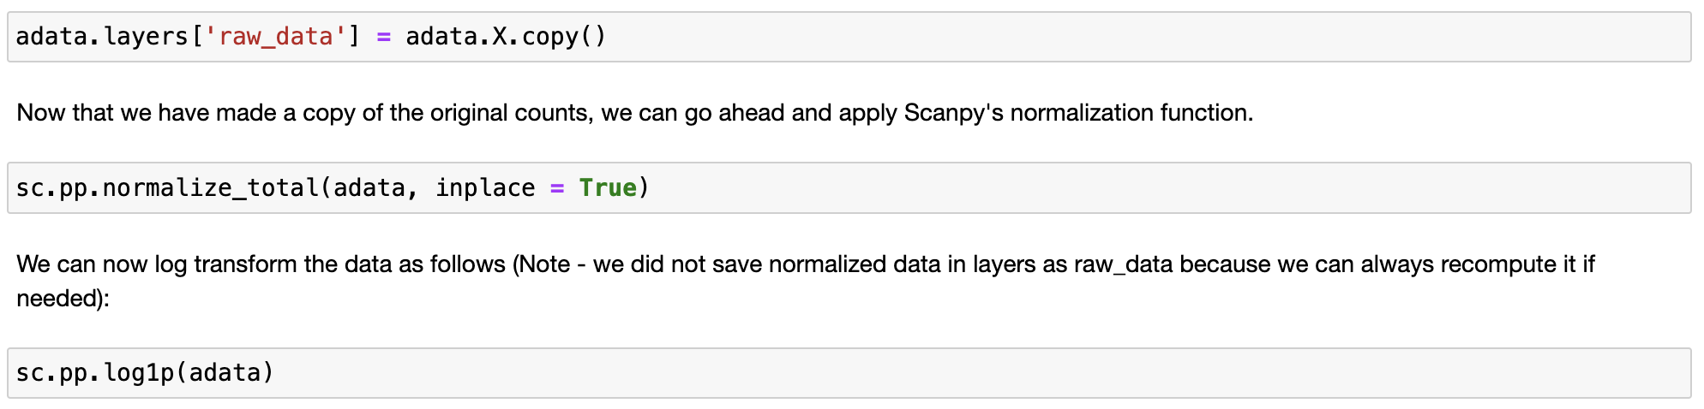
Data normalization – Method 1 (Median library size + log transformation)

Slide 30
Code development

Slide 31
Git vs Github
Command-line software that is installed locally and maintained by Linux
Manages various versions of edits made to files within a Git repository
Install locally
git ….
Service hosted on the web and maintained by Microsoft
Space to upload a copy of the Git repository
https://github.com/
Free for public repositories
Private repositories free for students

Slide 32
Key concepts in Git
Repositories
Short “repo”
Collection of all files and history of all files
Important commands:
git clone repo_url
Commit
Update your repo:
git add .
git commit -m ‘your-message-to-your-future-self’
git push
Branches

Slide 33
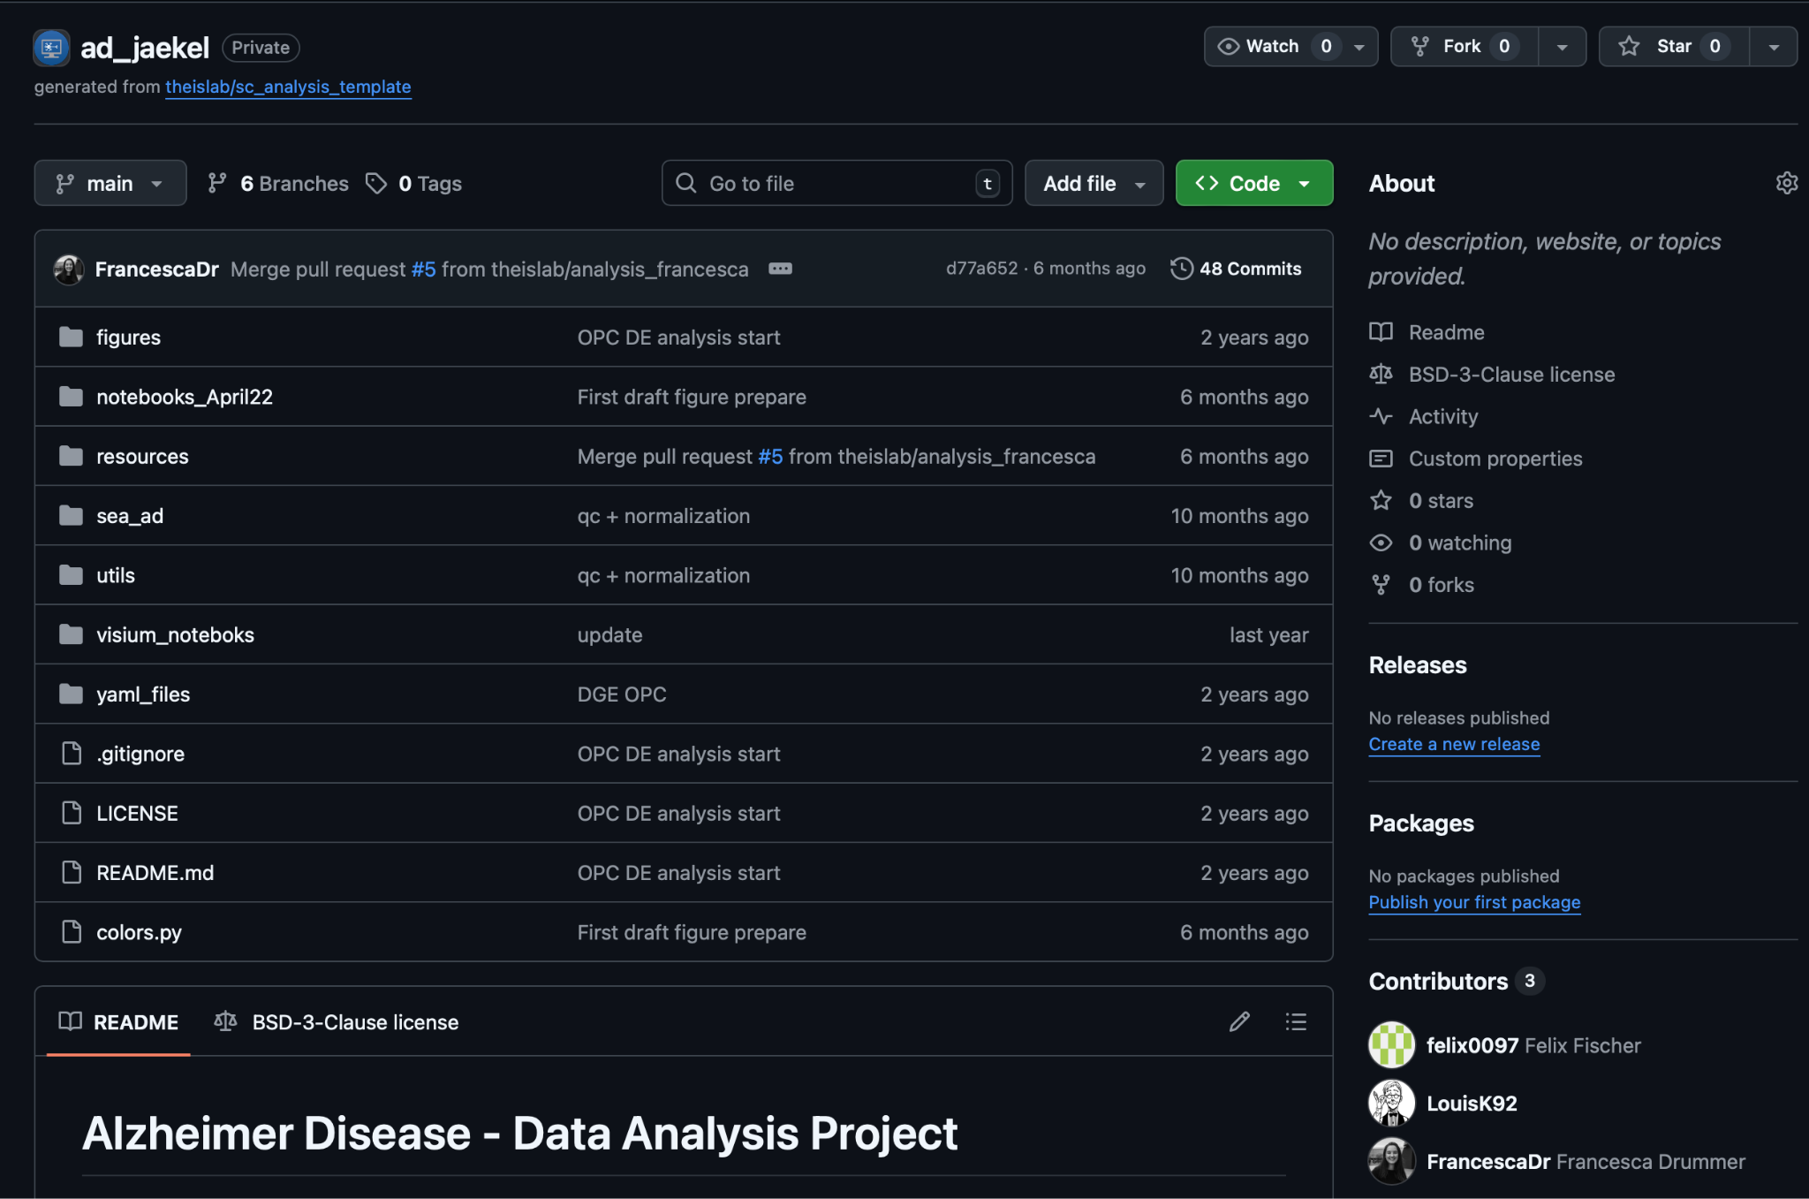
Repo name

Slide 34
Tips and tricks
Check if a package is being maintained before using it
If you are stuck: check out the issues
Likely there was already someone having the same issue
Or, you can raise your own issue and get help from the developers

Slide 35
Data sharing
Slide credits to Lukas Heumos and LaminDB team

Slide 36
Single-cell data platforms
For example:
cellxgene: https://cellxgene.cziscience.com/datasets
Synapse: https://www.synapse.org/
GEO: https://www.ncbi.nlm.nih.gov/geo/
SEA-AD AWS: https://registry.opendata.aws/allen-sea-ad-atlas/
The Human BioMolecular Atlas Program (HuBMAP): https://commonfund.nih.gov/HuBMAP
Problem: All different data formats (Python vs R), access requirements etc
In this context we use LaminDB:
own instance: theislab/ad_jaekel
all formatted AD data

Slide 37
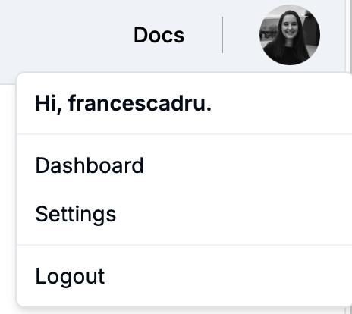

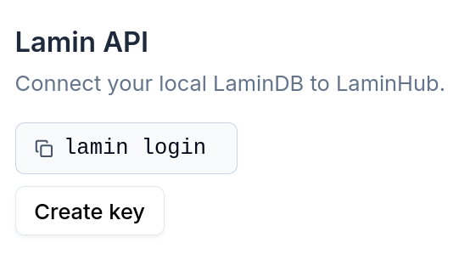
Signing up

Slide 38
Setting up LaminDB
Install lamindb via pip install “lamindb[jupyter,bionty]”
Log in with lamin login
First time user, sign up at https://lamin.ai
Connect to an instance with lamin connect account/instance
lamin connect laminlabs/cellxgene
lamin connect theislab/ad_jaekel
https://docs.lamin.ai/setup

Slide 39
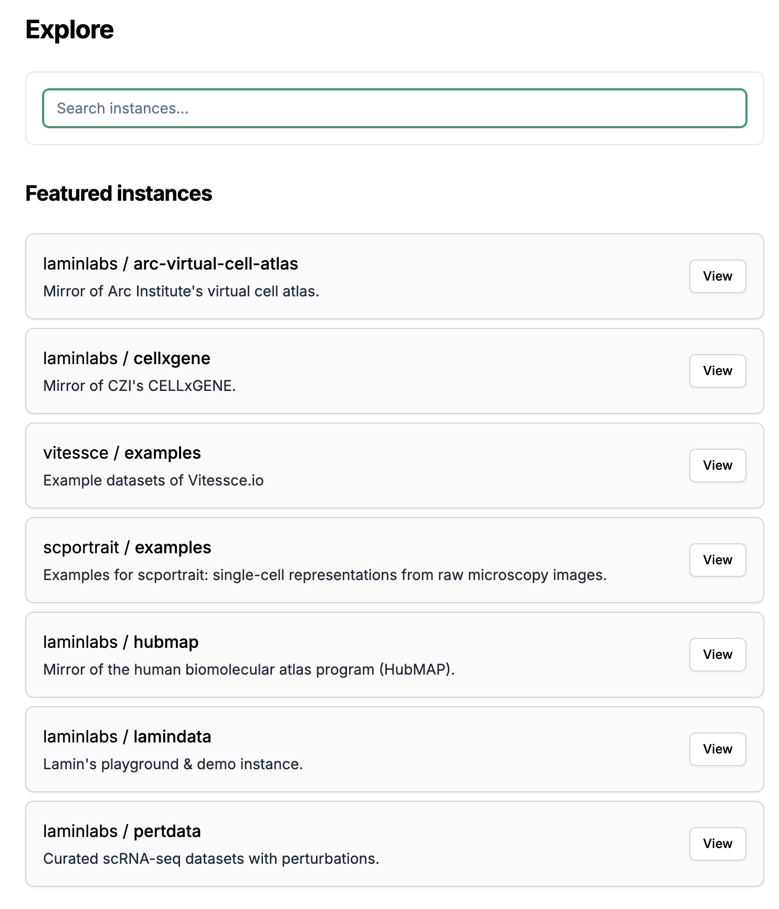
Leverage external LaminDB instances
Instance is basically a folder where you can find data objects
https://lamin.ai/explore

Slide 40
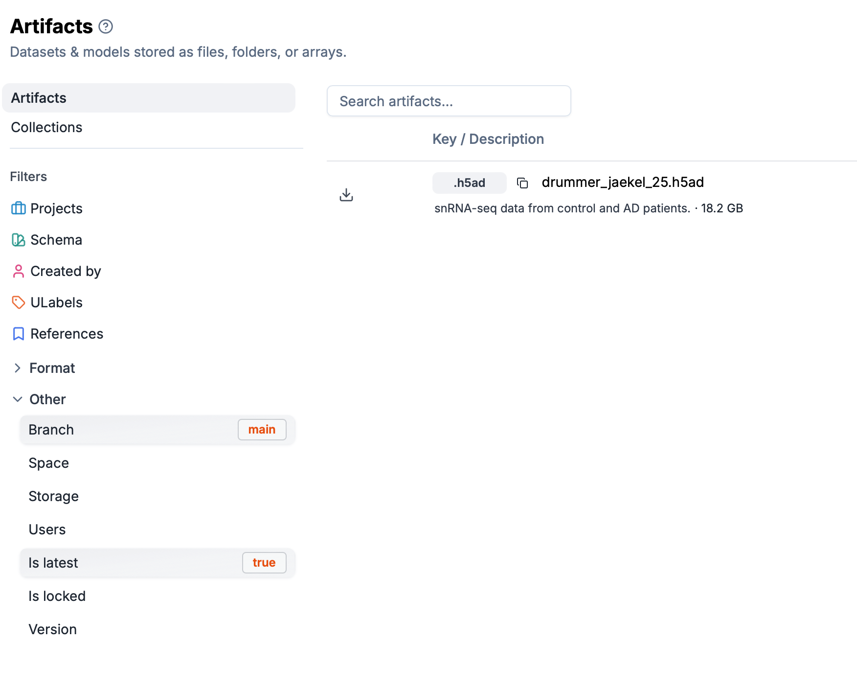
Artifacts are datasets
https://lamin.ai/explore

Slide 41
Let’s code 👩‍💻
Open VM
git clone https://github.com/FrancescaDr/jaekel_single_cell_tutorial.git
Run notebook 1: QC and normalization

Slide 42
Post data pre-processing: - Data normalization - Highly Variable Genes - PCA - Nearest Neighbor Graph - Visualization - Clustering

Slide 43
Highly Variable Gene Selection
Generally, all genes may not be important to understand the biology
A key idea in machine learning: feature selection
Not all the features that we collect are useful to understand the phenomenon
For example, in biology we expect to see lots of house keeping genes
Solution proposal: Focus on the genes that are highly varying, i.e. how much gene expression varies between cells
Assumption: Genes that have low variance may not indicate any biological signal in the data
Taking out those genes might therefore strengthen the signal in the data, while reducing nuisance signal
It moreover makes computations faster, since the number of genes is often reduced dramatically after performing HVG selection (minor benefit)
How do we identify varying genes: those that diverge from the general trend in variance.
Catch: Variance of a gene is generally proportional to its mean expression, therefore we consider coefficient of variation (variance normalized by the mean) against the mean of the gene

Slide 44
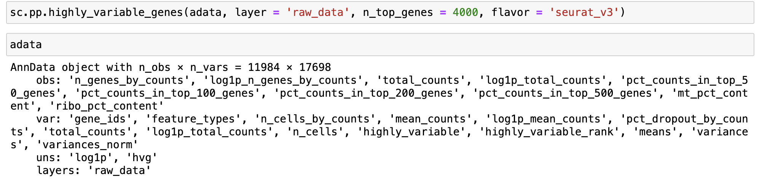
Highly Variable Gene Selection
Notes:
Important Note:
Once you compute HVGs, please check to find if the genes you know are relevant to your study are included in that list or not.
If not, please feel free to manually append them to the list.

Slide 45
Post data pre-processing: - Data normalization - Highly Variable Genes - PCA - Nearest Neighbor Graph - Visualization - Clustering

Slide 46
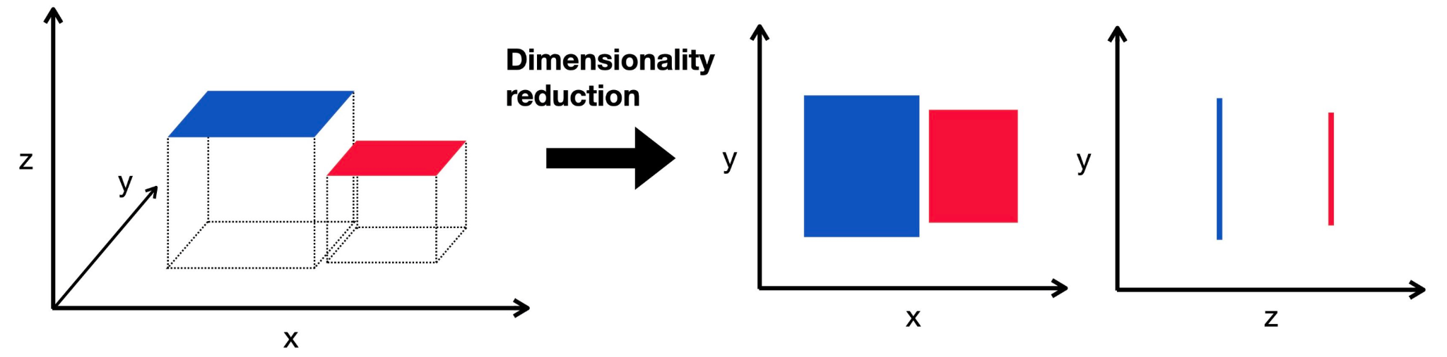
Dimensionality reduction, PCA
PCA is a dimensionality reduction algorithm to obtain "directions of highest variances.”
What does dimensionality reduction mean?
A typical scRNA-seq experiment measures the mRNA transcripts of all the genes (~20,000)
These genes represent features or dimensions or parameters that we measure for each cell
These features define the phenotype of each single cell
Notes:
Key: Genes and their products inside cell form modules => a lot of genes are co-regulated and co-related
Thus, by measuring so many features from a single cell, we obtain redundant information
There might be only a few key variables (possibly hidden) that are driving the underlying biological process
The notion of dimensionality reduction is thus to extract those few meaningful dimensions that are reflective of the true underlying biological process

Slide 47
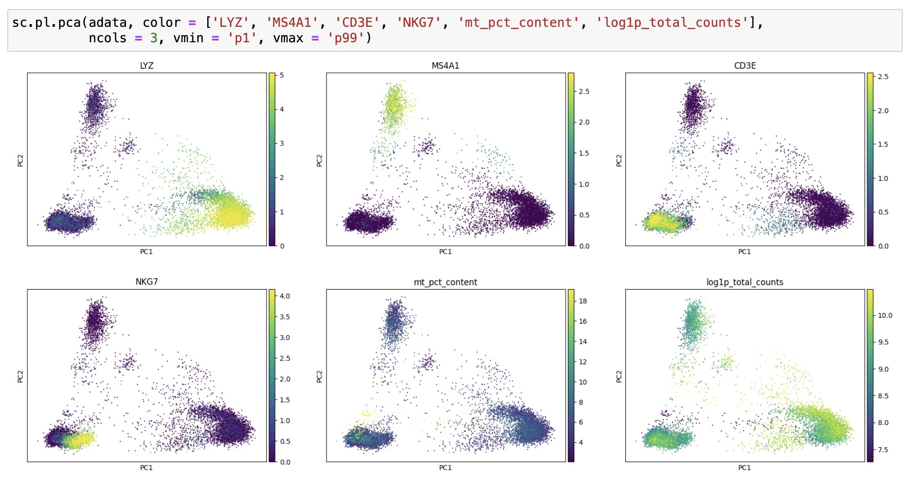
Dimensionality reduction, PCA
Can visualize data using the PCA, but still have 30 dimensions.
Moreover, PCA is a linear method and does not capture non-linear gene-gene relationships.
Need alternatives to summarize so much information.
Question: What do we want to capture using visualization?
Visualize in 2D or 3D
Ensure that cells with similar phenotype are plotted near each other => cells similar to each other in high dimensions must be visualized near each other in 2D
Ensure that non-linear relationships among the features (genes) are captured.

Slide 48
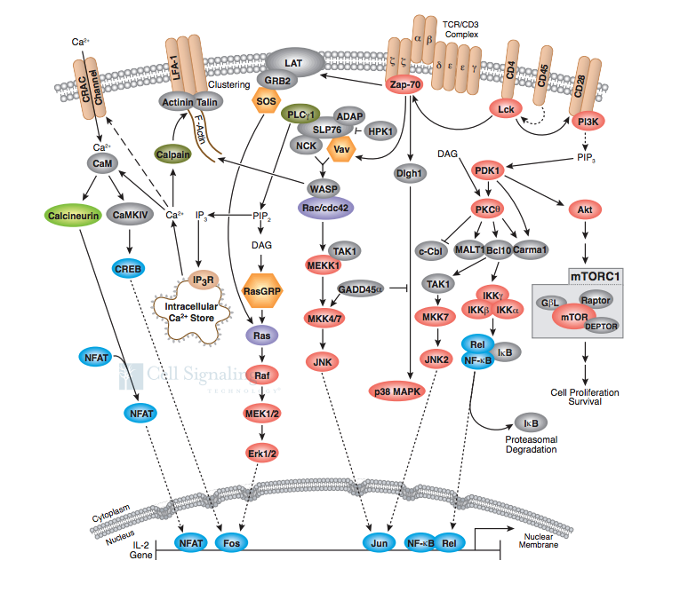
Why do we expect non-linearity in data?
Biological networks (gene network or protein networks) involve complex interactions such as feedback, feedforward, auto-regulation etc.
Results in non-linear relationships between genes and their products
Reflects as a well-regulated structure in phenotype space
https://media.cellsignal.com/www/pdfs/science/pathways/T_Cell_Receptor.pdf
Notes:
These properties come into play because biological networks (gene or protein) are complex.

Slide 49
Post data pre-processing: - Data normalization - Highly Variable Genes - PCA - Nearest Neighbor Graph - Visualization - Clustering

Slide 50
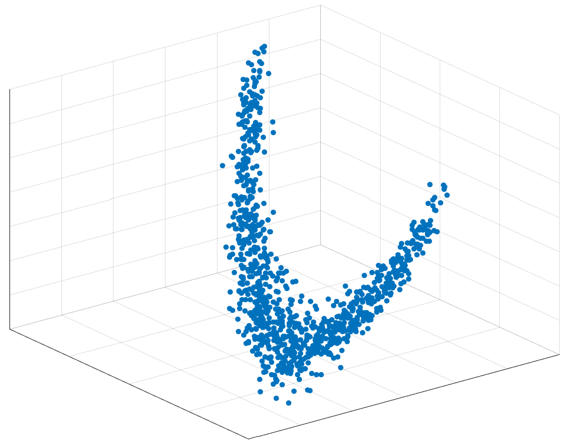
Non-linearity in the data
Gene C
Gene B
Gene A
Notes:
These properties come into play because biological networks (gene or protein) are complex.

Slide 51
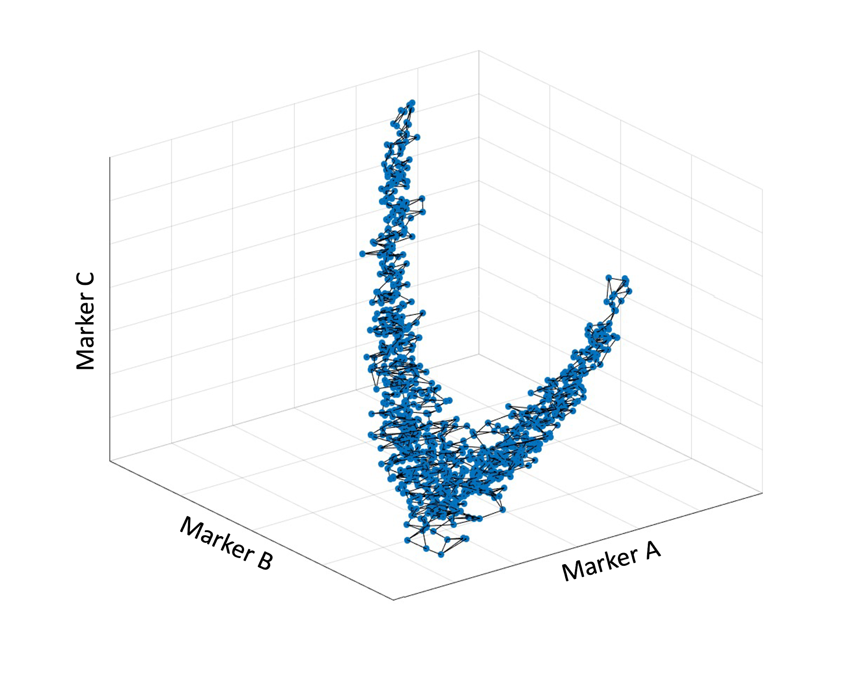
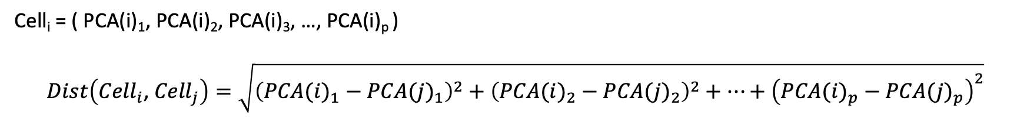
Graphs – applied to scRNA-seq data analysis
A
Gene C
B
Gene B
Gene A

Slide 52
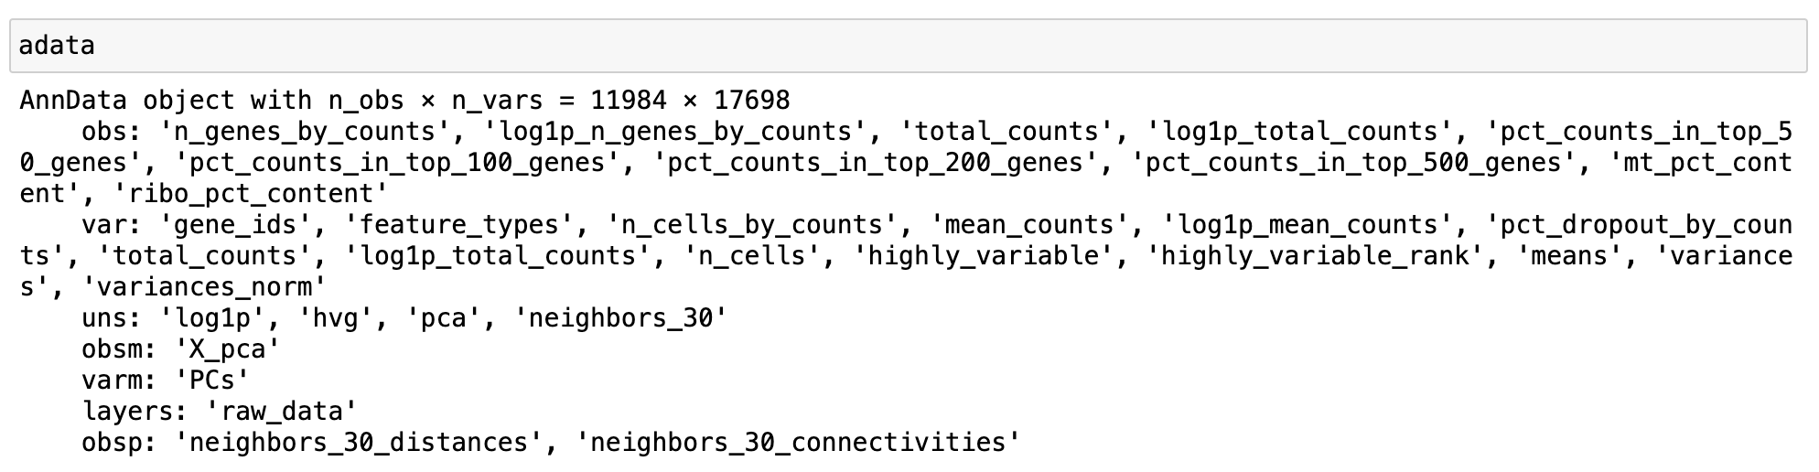
Computing knn-graph in Scanpy

Slide 53
Post data pre-processing: - Data normalization - Highly Variable Genes - PCA - Nearest Neighbor Graph - Visualization - Clustering

Slide 54
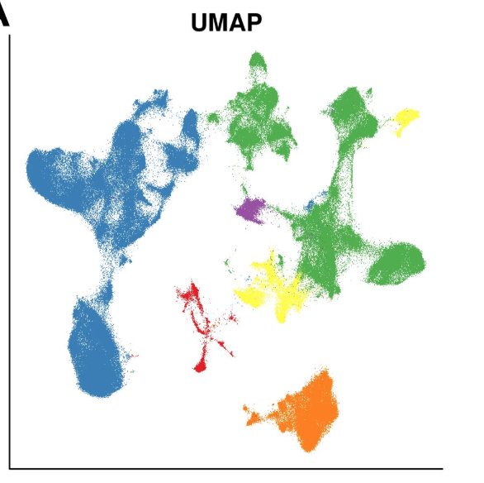
Data Visualization – UMAP
https://umap-learn.readthedocs.io/en/latest/how_umap_works.html Becht et. al. Nature Biotech 2019

Slide 55
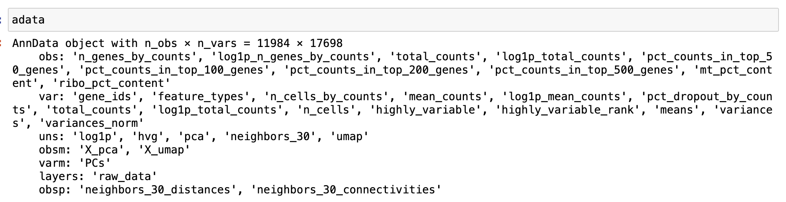
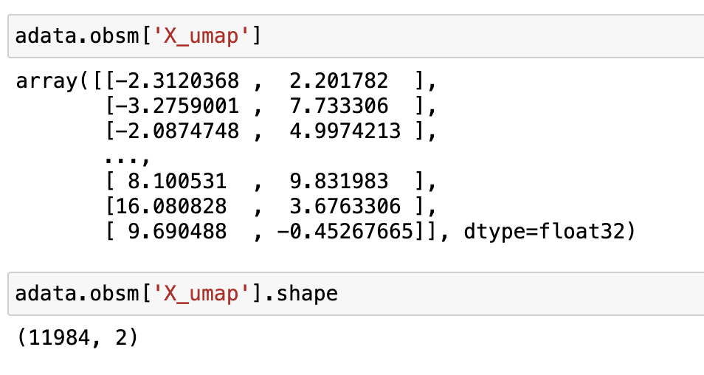
Data Visualization – UMAP

Slide 56
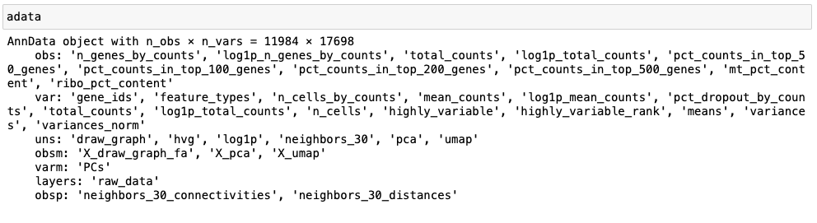
Utilizing visualizations for data analyses (Library size, number of unique genes per cell)

Slide 57
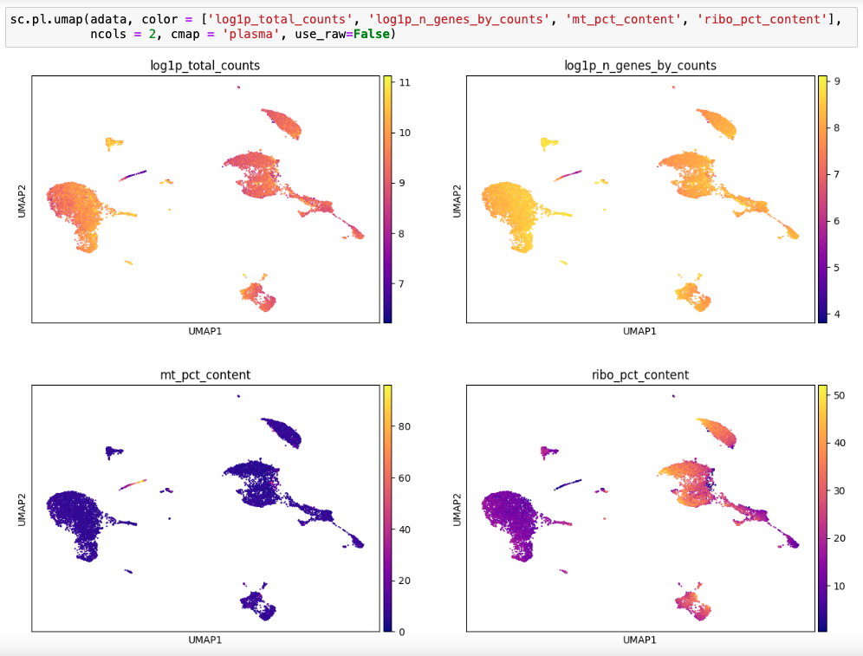
Utilizing visualizations for data analyses (Library size, number of unique genes per cell)

Slide 58
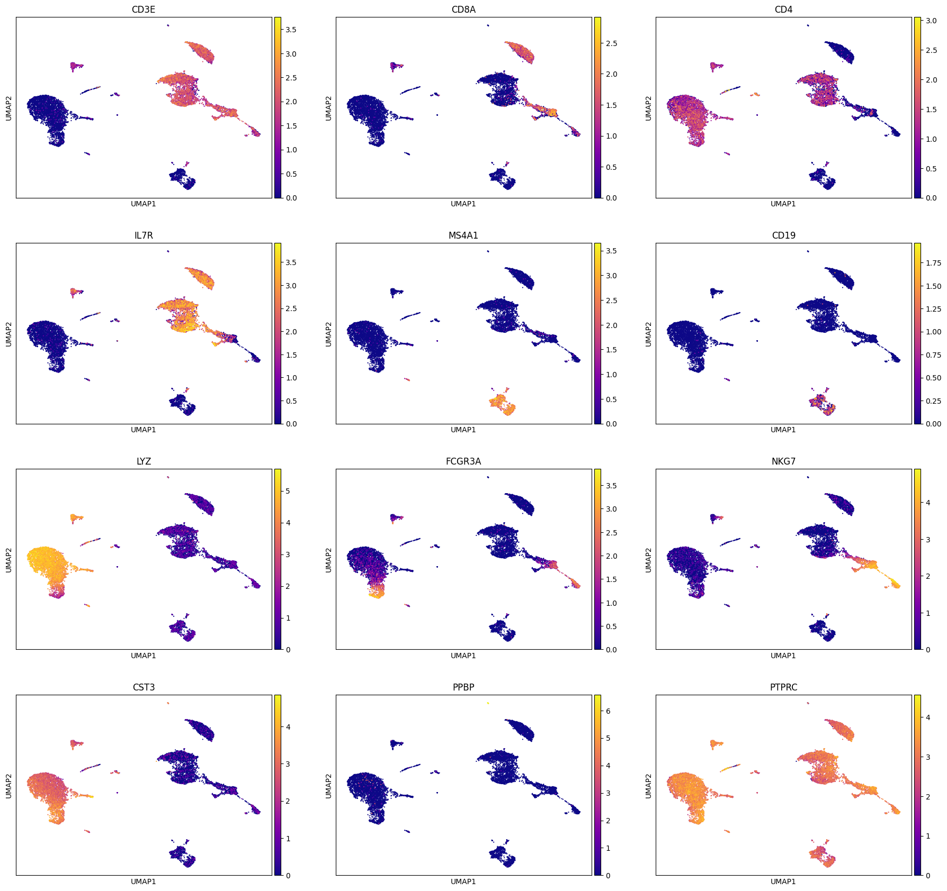
Utilizing UMAP visualizations: Gene expression

Slide 59
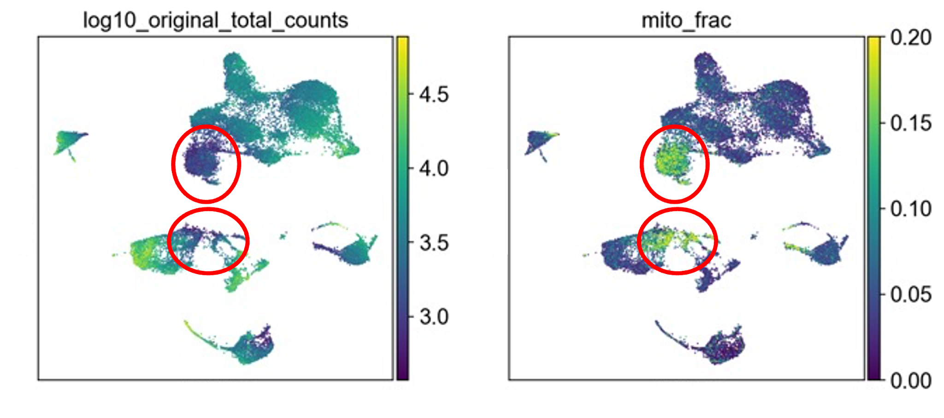
Utilizing UMAP visualizations: low quality
https://www.nature.com/articles/s43018-022-00443-5#Sec54

Slide 60
Post data pre-processing: - Data normalization - Highly Variable Genes - PCA - Nearest Neighbor Graph - Visualization - Clustering

Slide 61

Cell clustering
Want: Identify cells that are similar to each other and group them together
We have already constructed similarity metric between cells based on the k-nearest neighbor graph
Then cells will be grouped based on some optimization metric
Consider two approaches:
Leiden clustering
Jaccard + Leiden clustering (PhenoGraph)
Marker C
Marker A
Marker B

Slide 62
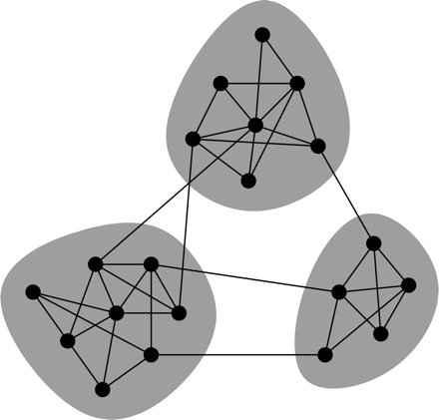
Leiden clustering
Shown to be optimal for different criteria such as Modularity and Constant Potts Model:
Modularity is a metric of connectedness
Try to maximize the number of edges within a cluster compared to an expected value
CPM measures the density of edges within a cluster against between clusters
Want more edges within a cluster
Want fewer edges between clusters

Slide 63
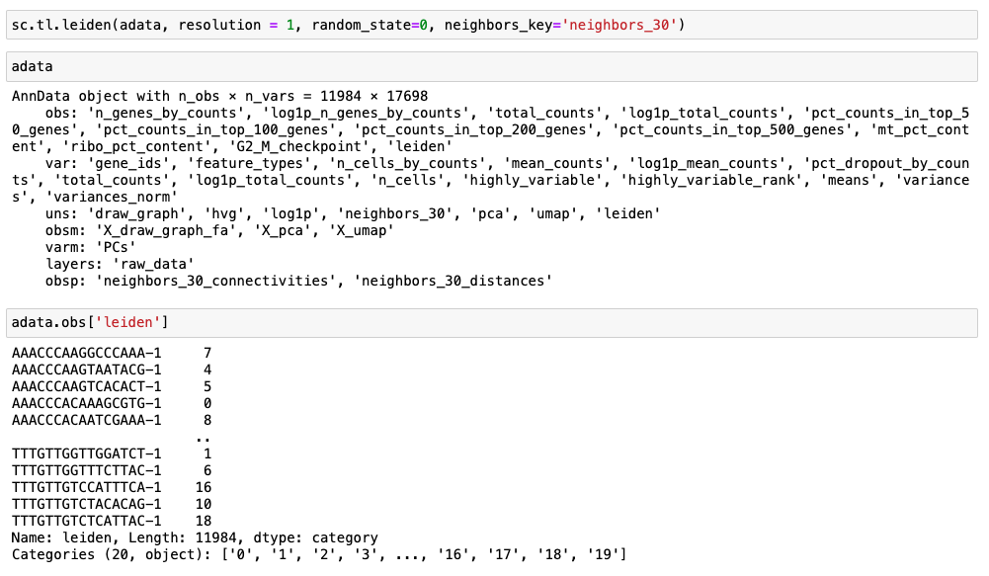
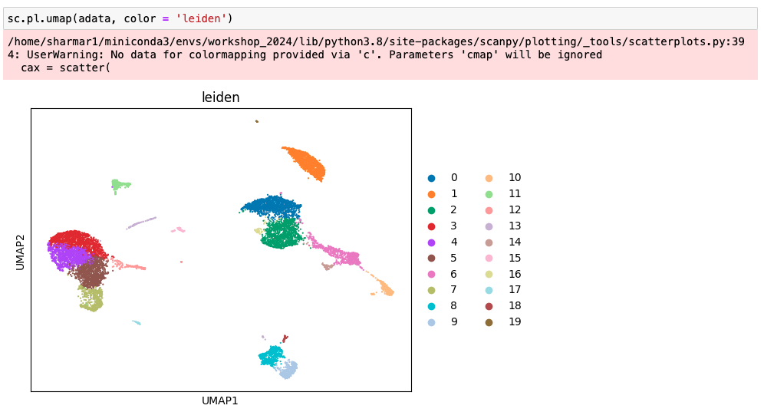
Leiden clustering in Scanpy

Slide 64

Applying clustering for data clean up
We have argued that we want to remove the circled set of cells.
We can now use the clusters we have to isolate and remove each cluster one at a time.

Slide 65

Applying clustering for data clean up
We have argued that we want to remove the circled set of cells.
We can now use the clusters we have to isolate and remove each cluster one at a time.

Slide 66
Recap
Library size distribution; Number of uniquely expressed genes per cell
scRNA-seq data matrix
Pre-process and QC
Number of cells each gene is expressed in
MT-content
Visualization: UMAP
Doublet Detection
Clustering: Leiden
Graph
PCA, dimensionality reduction
Data Normalization (Median library size + log transformation)
Imputation
Differential Expression, GSEA
Trajectory Inference, Factor Analysis

Slide 67



Happy learning! 🤓
www.youtube.com/@scverse
https://www.sc-best-practices.org/
https://scverse.org/learn/
Questions?
Hands on coding

